Slide 1

CGCSA Summit 2023
Pilot App Demo
CGCSA Team
11 October 2023
Notes:
Play Video 50th Video as the opening loop

Slide 2


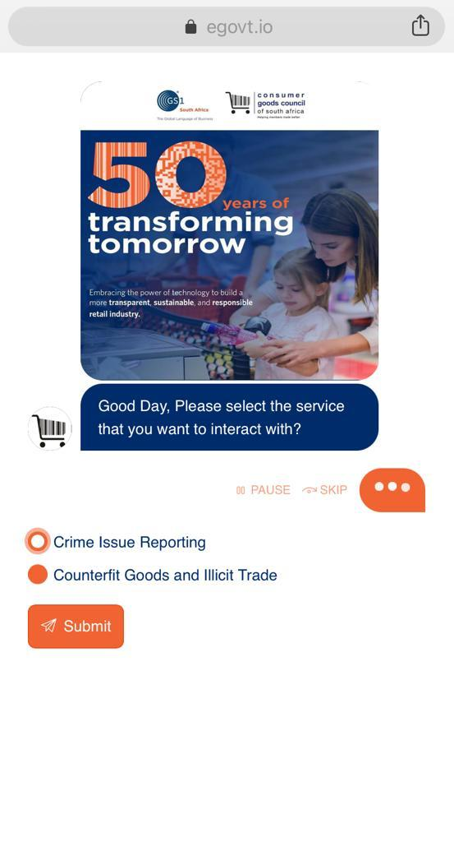
CGCSA App and Verified by GS1
https://egovt.io/gs1/
This year we celebrate the barcode
and 50 years of transforming tomorrow.
Notes:
Viresh to introduce Zinhle

Slide 3
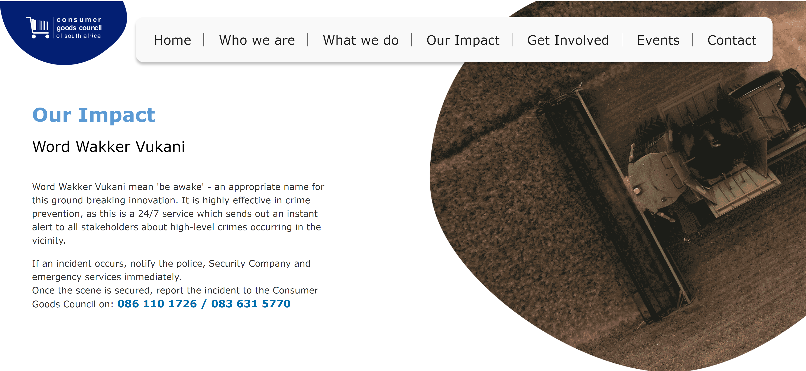
Notes:
As we launch our new revamped website today we are excited to have abie tell you about the how we put the Word Wakker Vukani initiative ramp up with a app we are piloting on behalf of our members

Slide 4
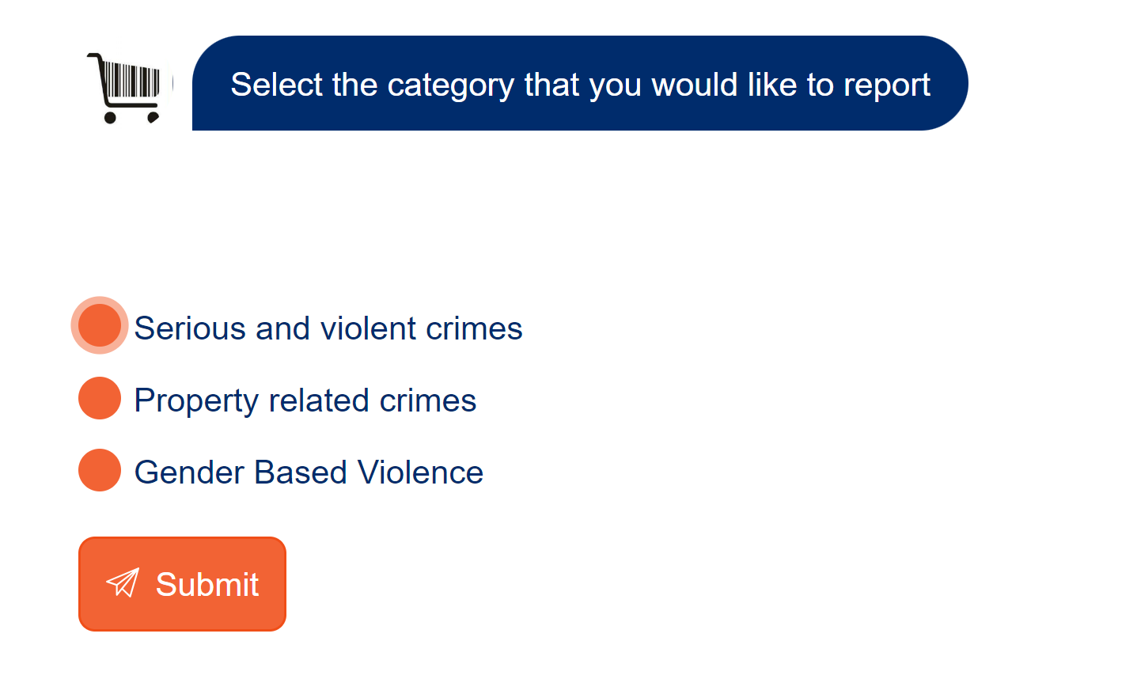
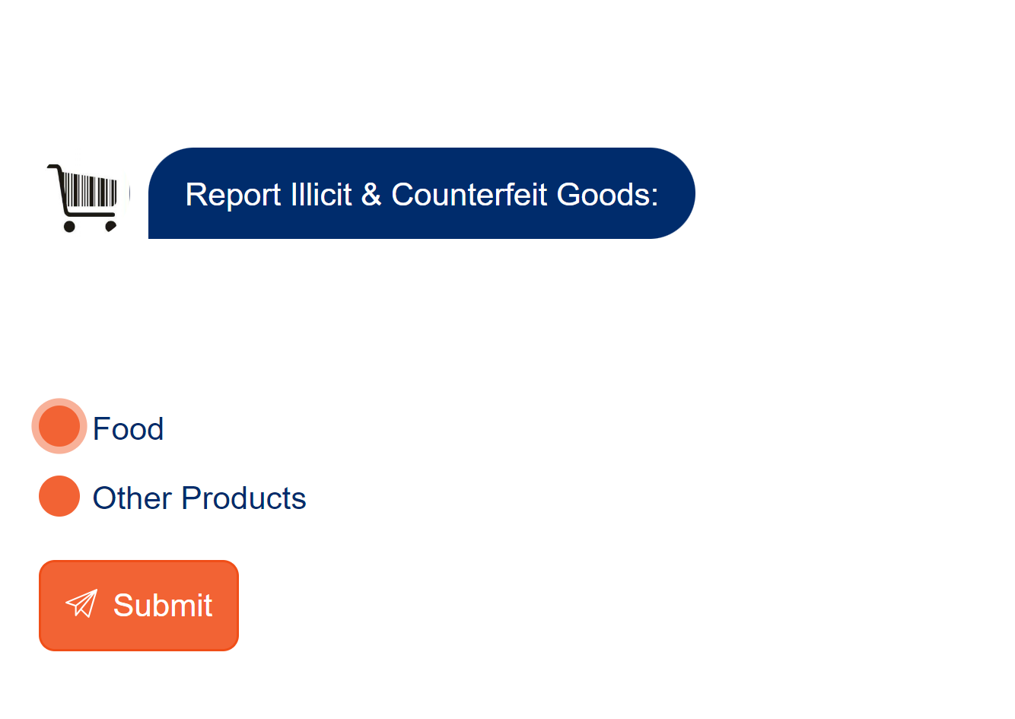
Let’s report a Crime Linked to a Food Product!

Slide 5
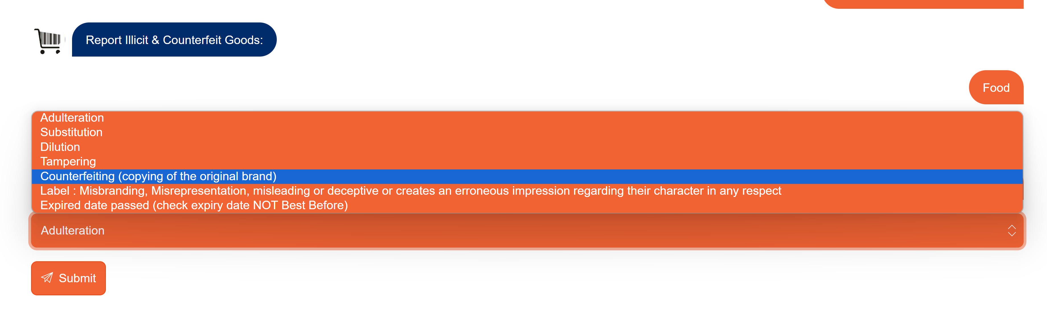
Our Members and Consumers can easily report

Slide 6
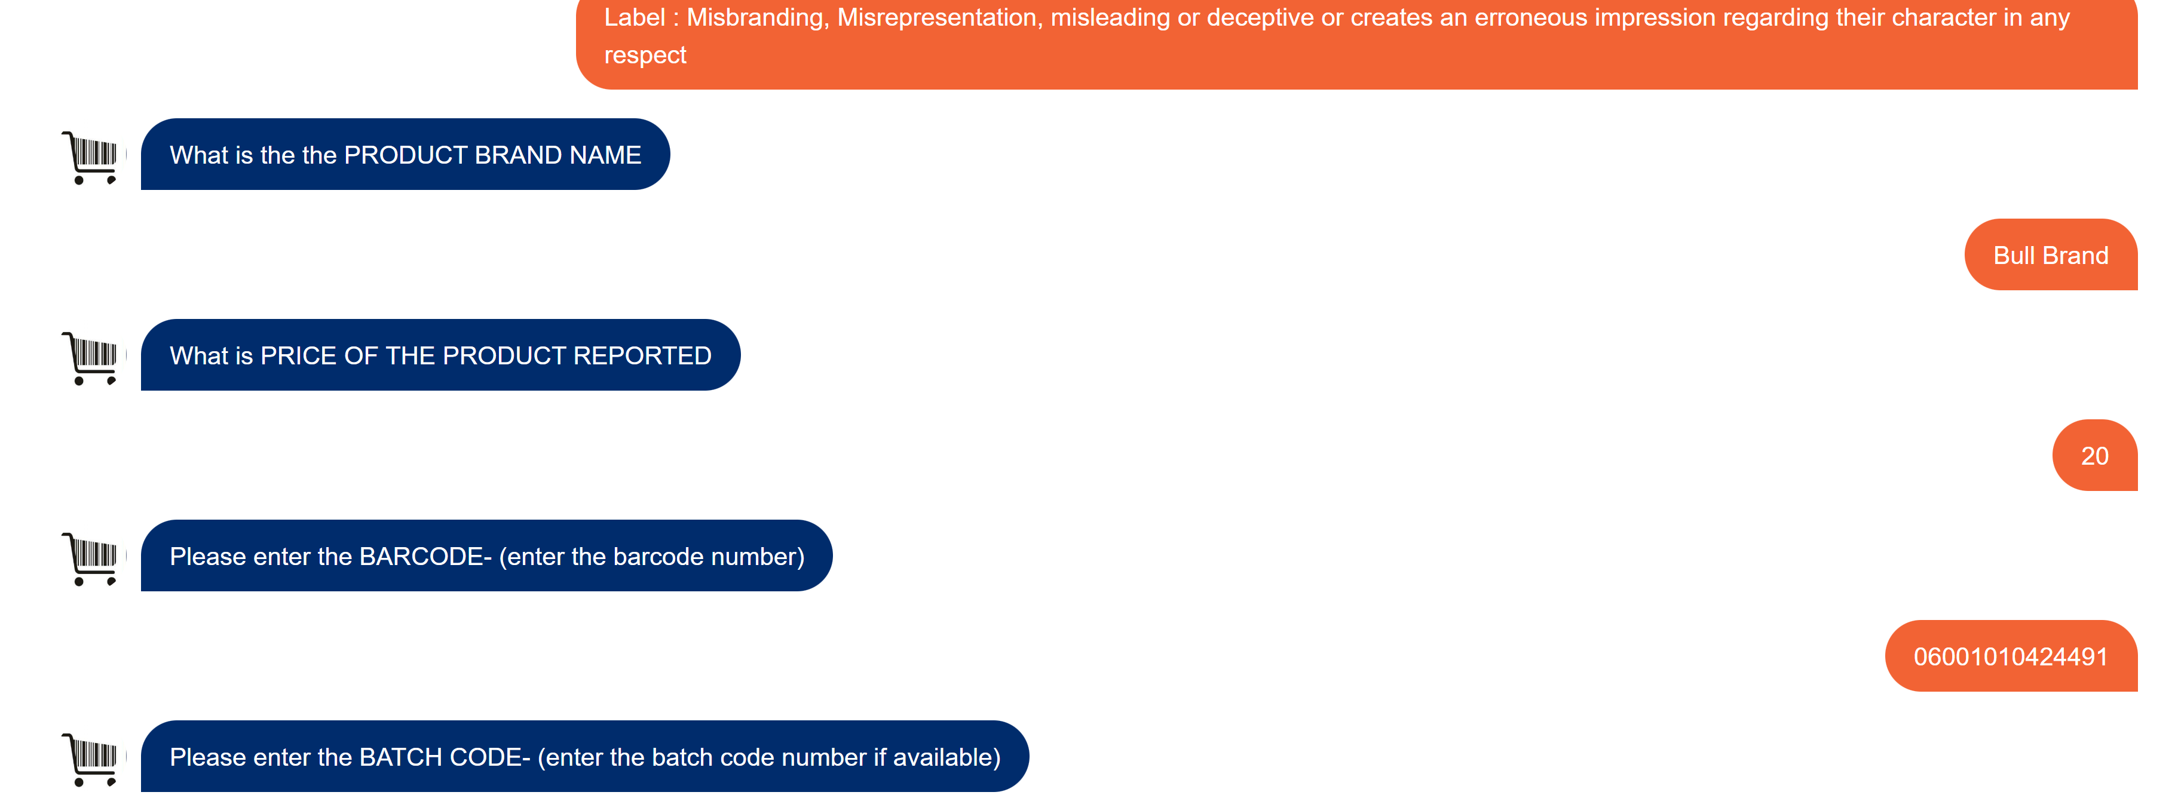
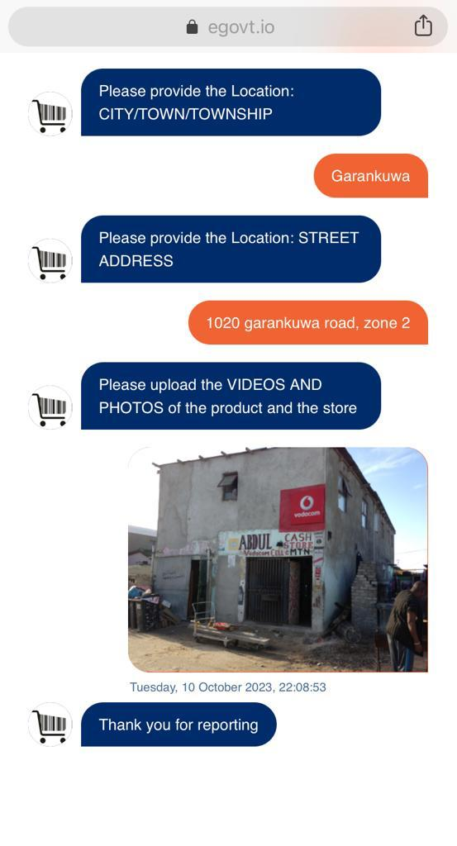
The Consumer is prompted to answer a few products

Slide 7
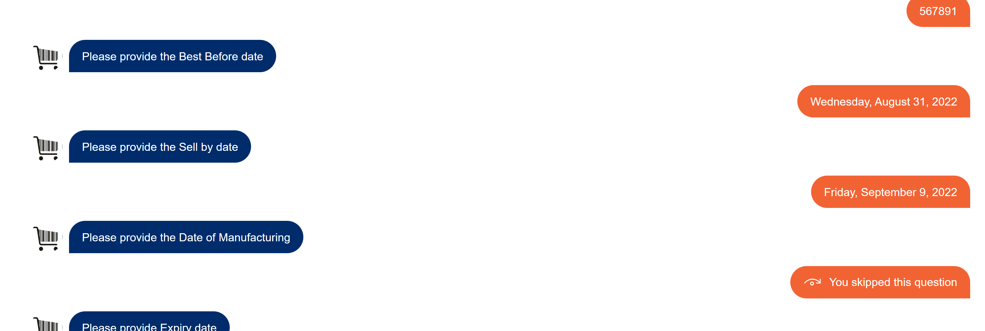
Can add a Location and Image

Slide 8


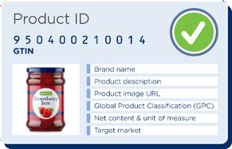






The Future of Verified by GS1- Links to Data
Functionalities

Slide 9
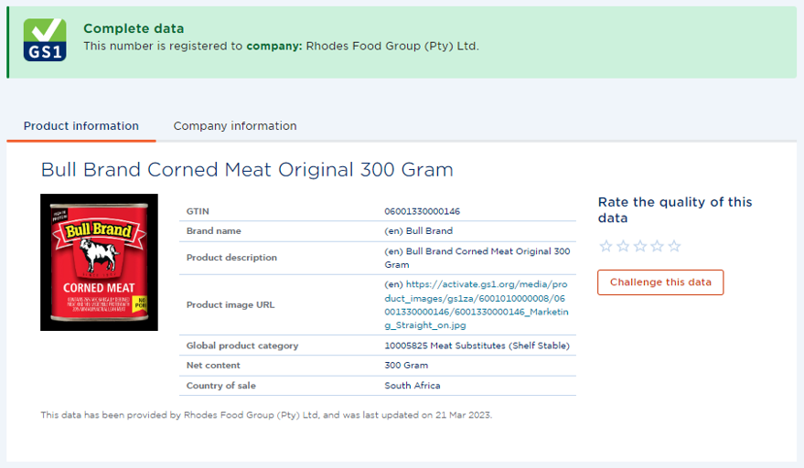
Verified by GS1 Search
Able to Search by GTIN and get basic product and Company Information
Notes:
06001010424491

Slide 10
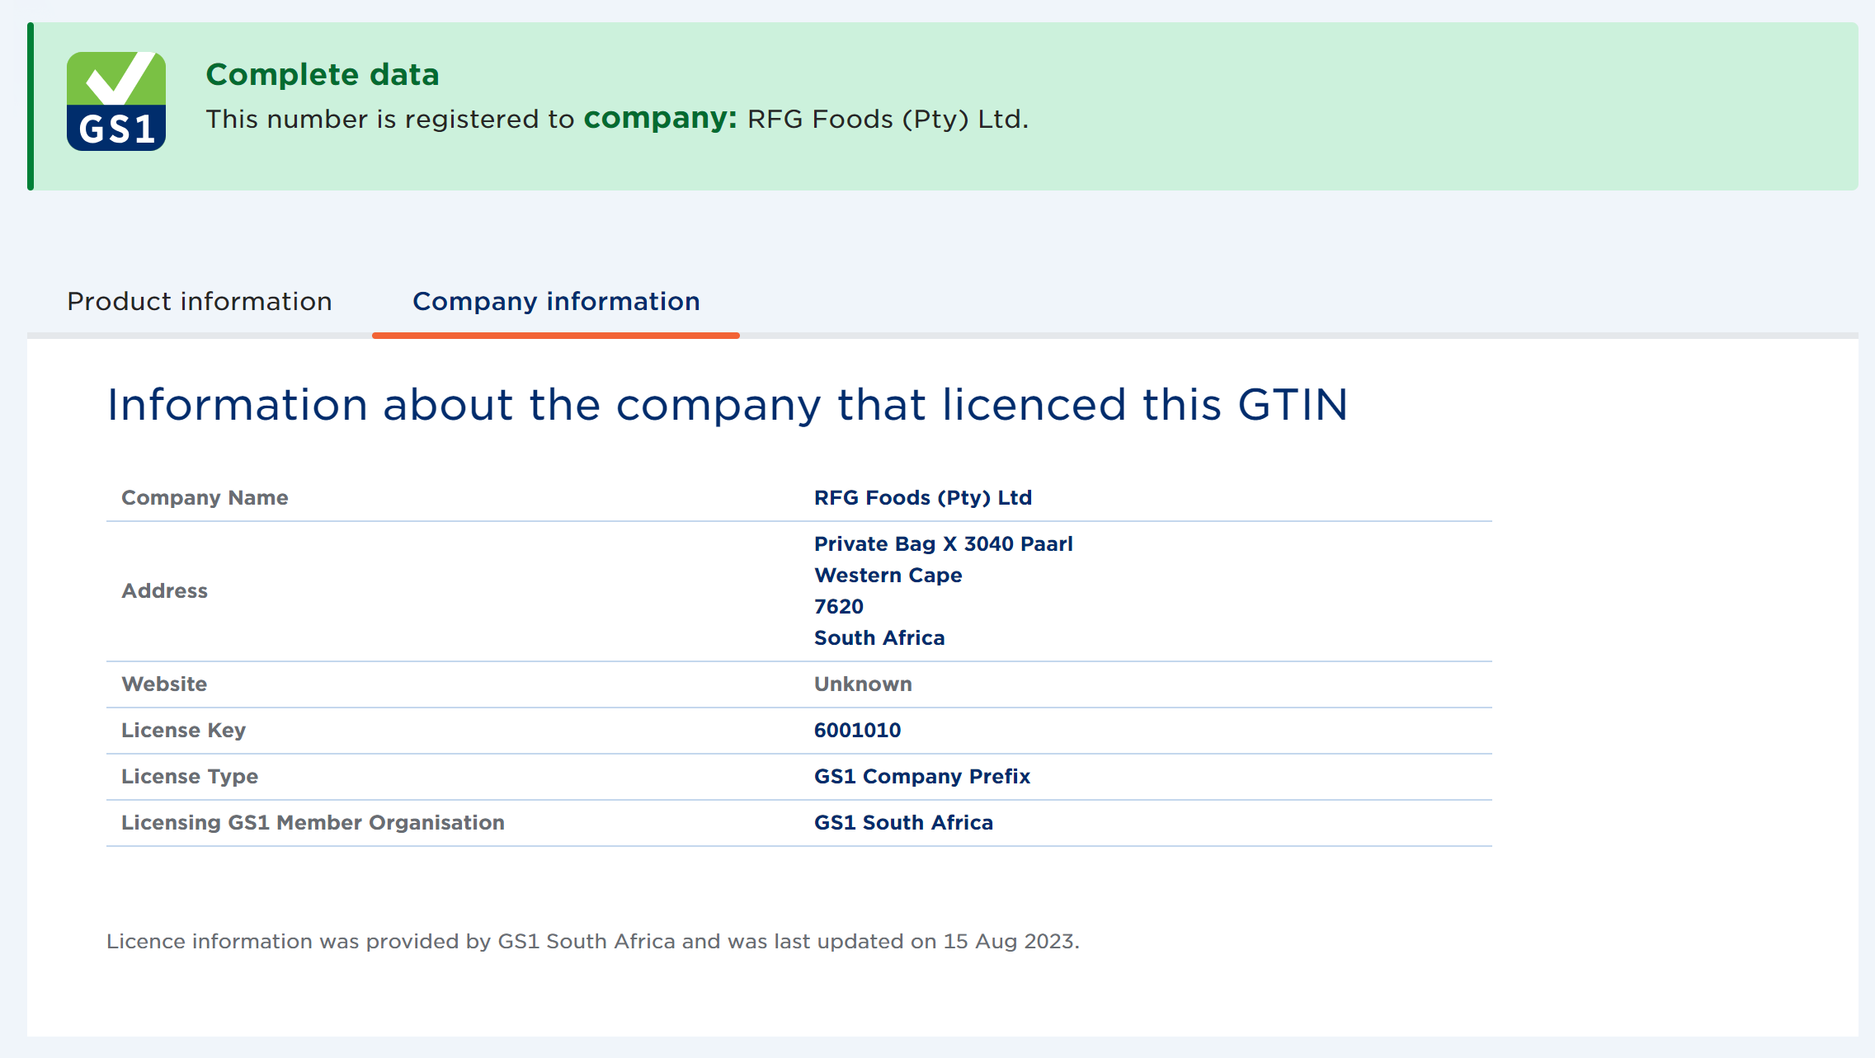
Trusted Brand Owner Information

Slide 11
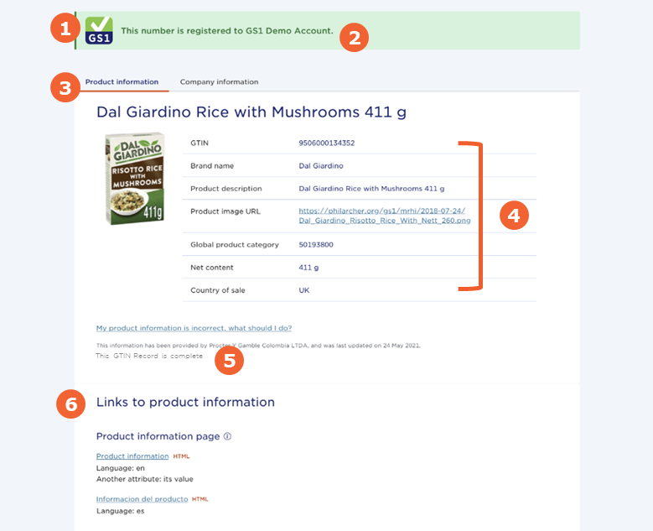
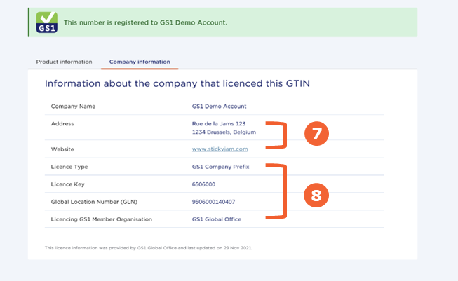
Product Information
Company Information
Verified by GS1 is a unique source of company and product data that has continued to grow in value.

Slide 12


44

